Slide 1
Exhaustive Enumeration of Split Lines
“How do we know this is the best map possible?”

Slide 2
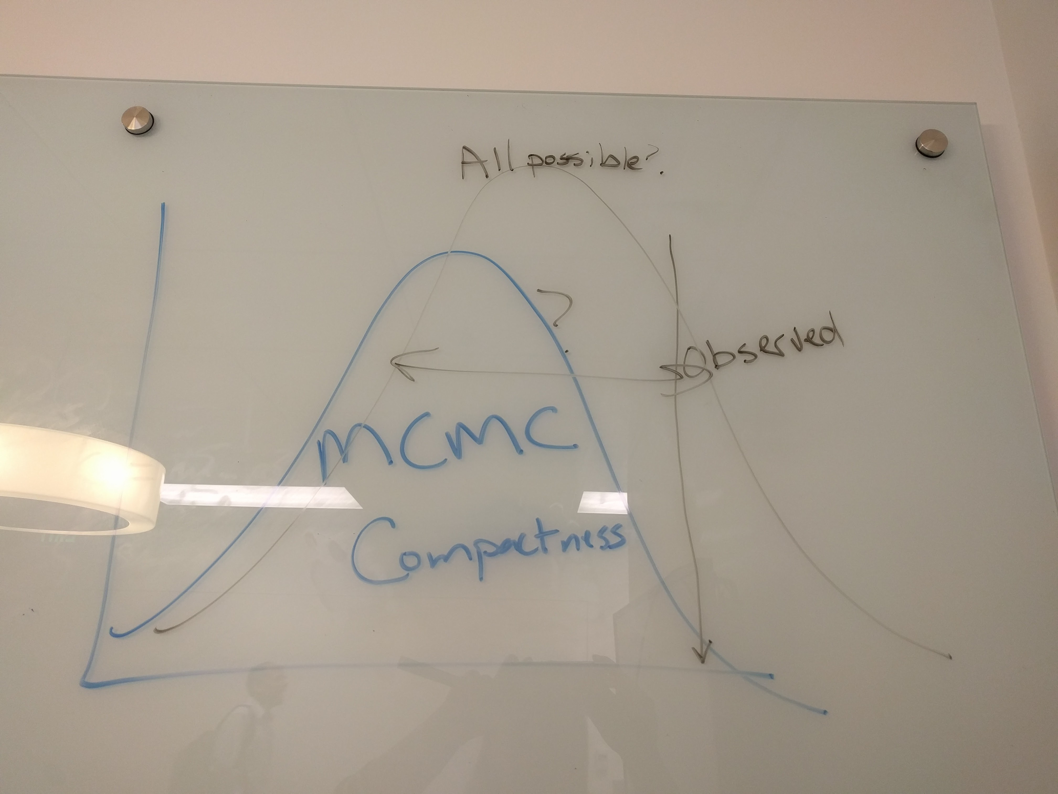
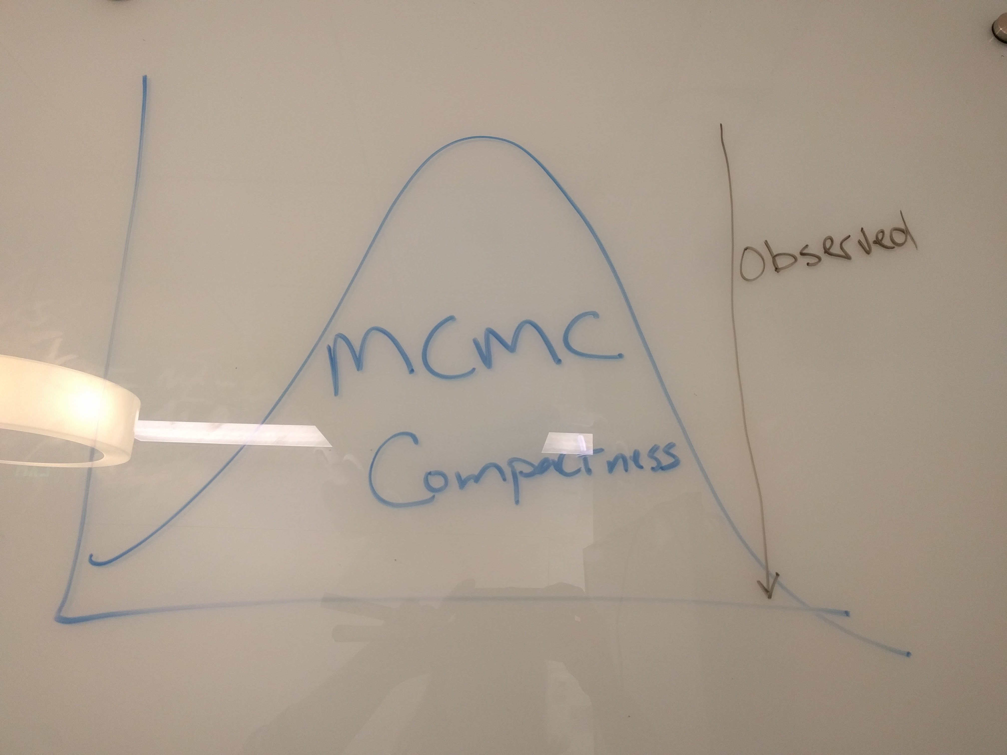
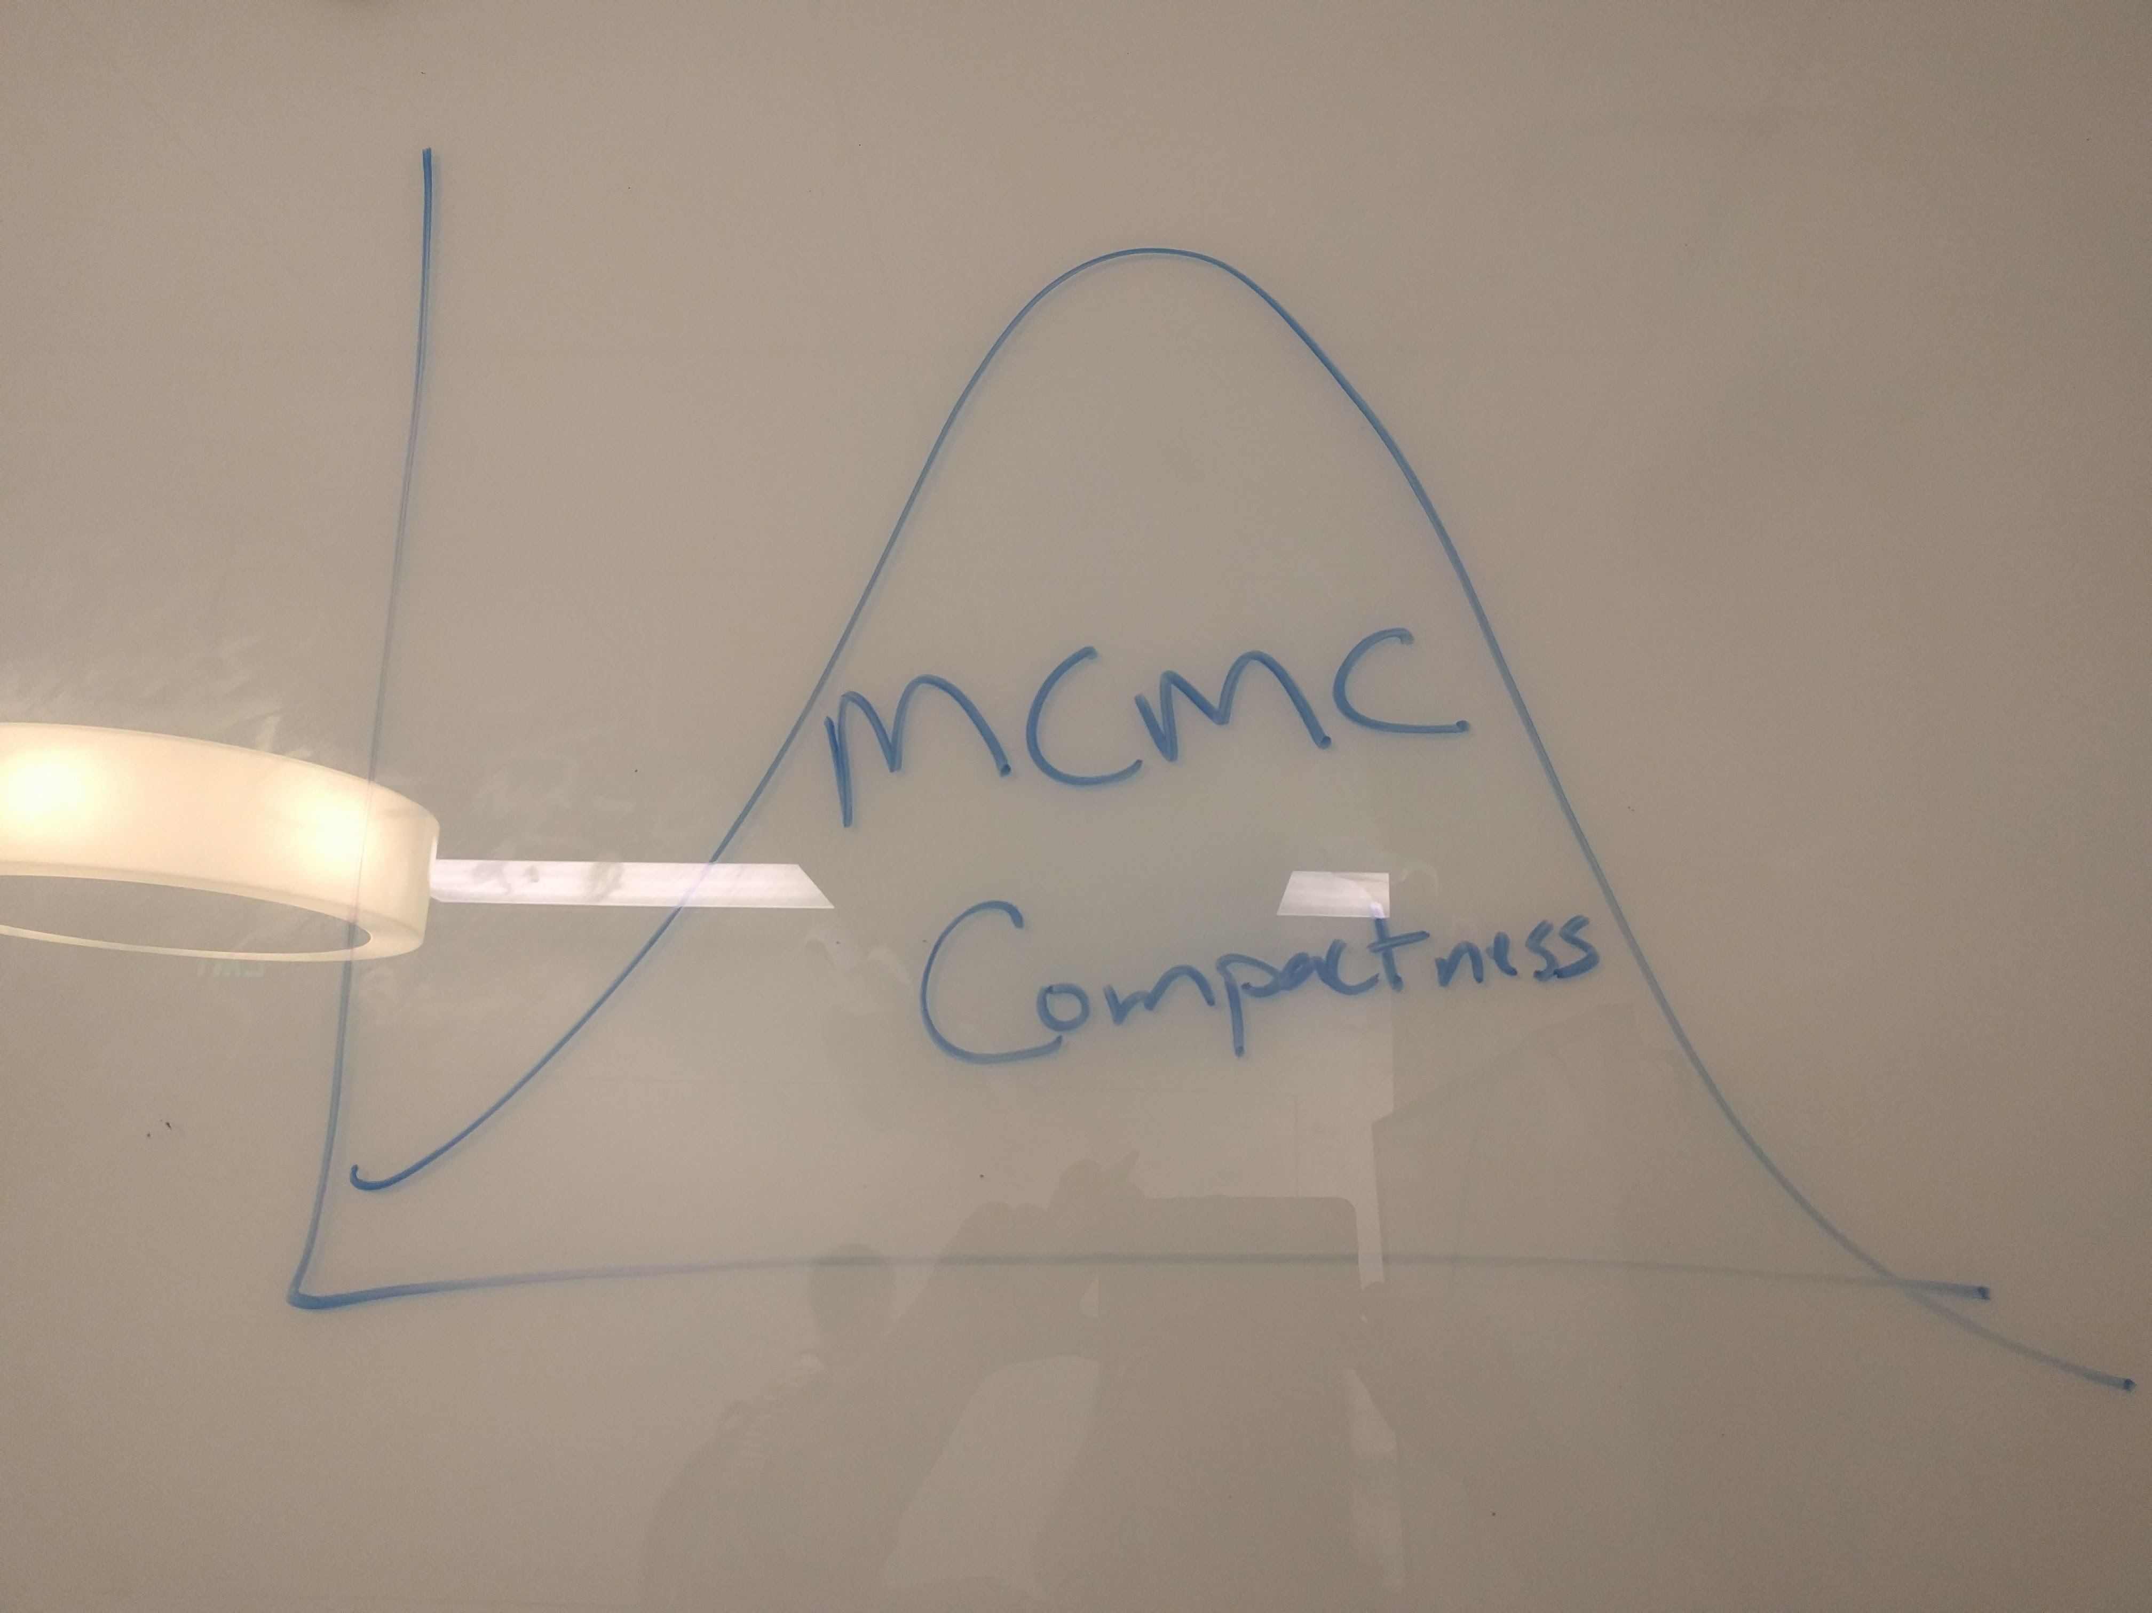
Problem Set
Monte Carlo Simulation – random sampling
“How do we know we’ve got the WHOLE picture?”
Enumerate the entire set of possibilities

Slide 3
Processing Steps
A
B
Dual Graph
(midpoints of shp features)
C
Shapefile
(Precincts)
1
Primal Graph
3
2
4
Distribution Graph
Edge Map
A | C | 3 | 4
A | B | 1 | 4
B | C | 4 | 2

Slide 4
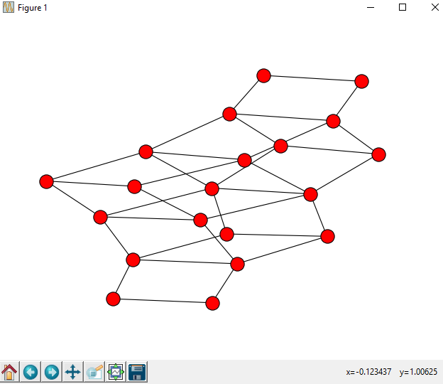
Processing Steps
District 1 | District 2
B | AC
C | AB
A | BC
Edge Map
All permutations of Simple Lines
Metadata Network Graph
1
Polsby Popper (each permutation)
A
B
3
C
2
4
Distribution Graph
Nodes: redistricting map

Slide 5
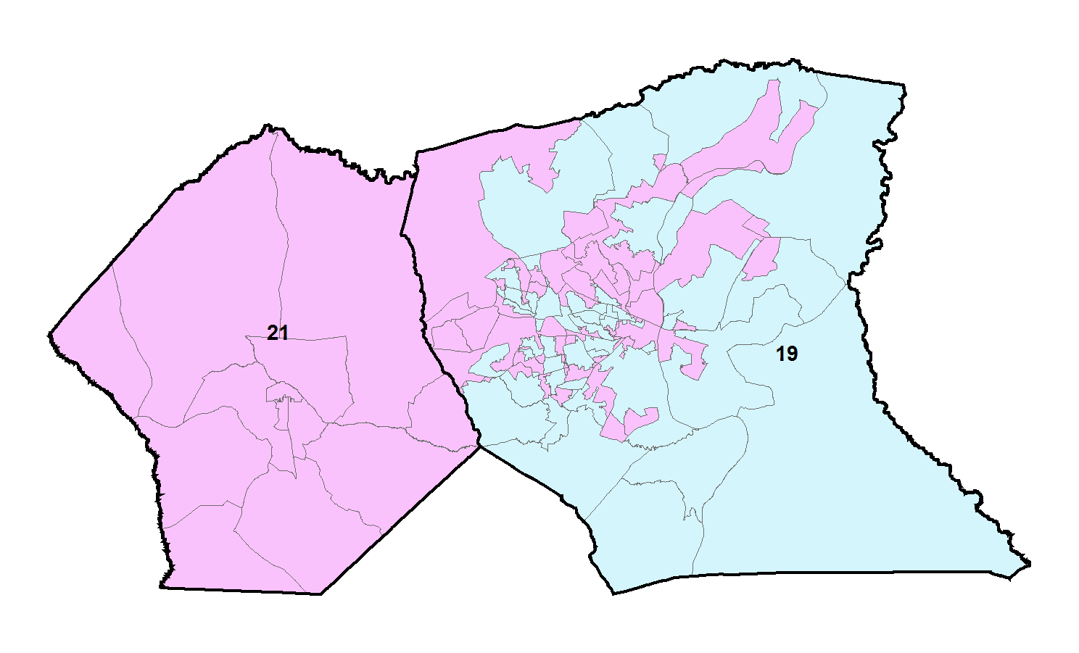
Hoke and Cumberland Counties

Slide 6
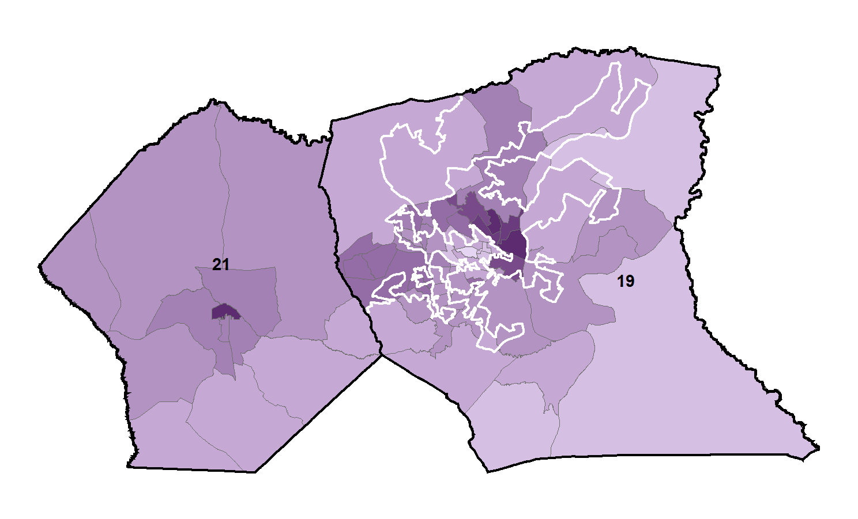
Hoke and Cumberland Counties

Slide 7
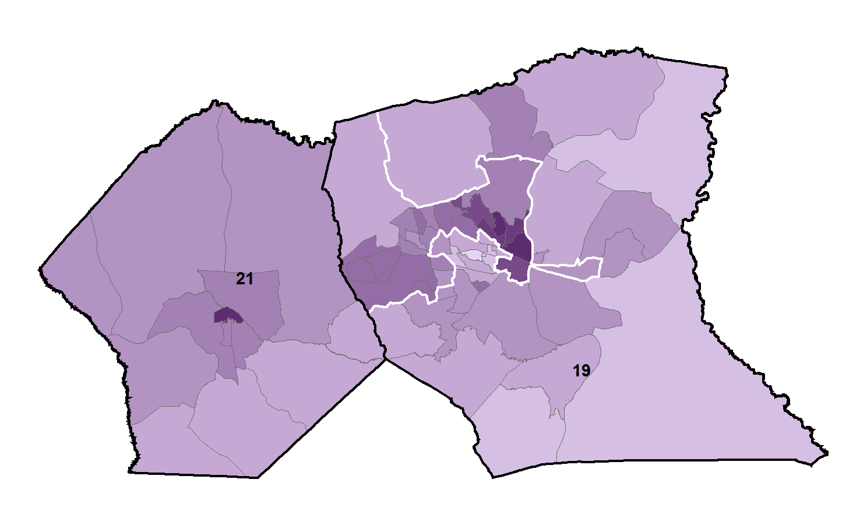
Hoke and Cumberland Counties

